Slide 1
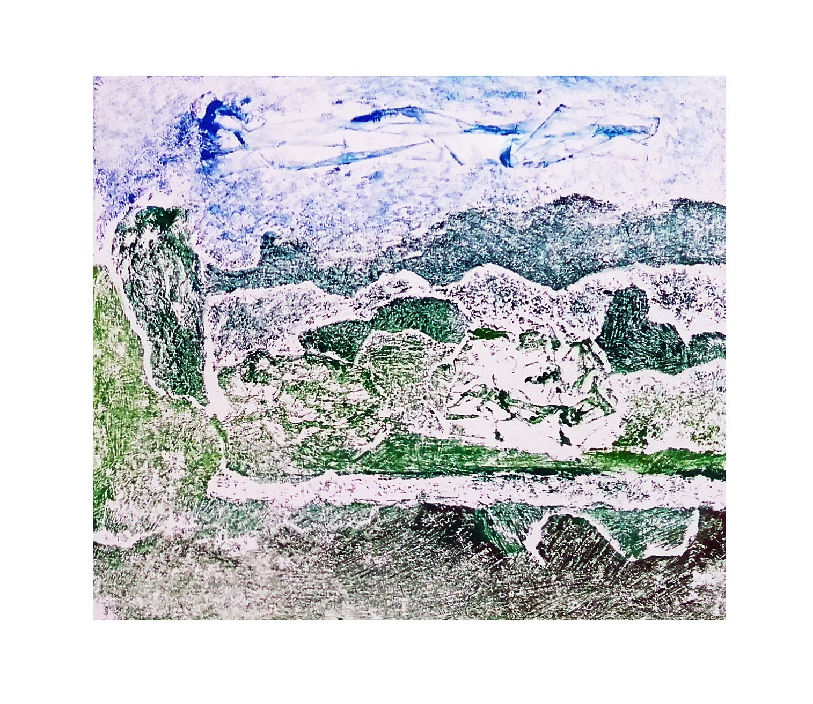
Collagraph Printing

Slide 2
Collagraphy
Collagraphy was introduced in 1955 by Glen Alps and is a printmaking process in which materials are applied to a rigid substrate. The word is derived from the Greek word koll or kolla, meaning glue, and graph, meaning the activity of drawing. (Glue Drawing)
Collagraph is a basic method of printmaking using a board with collaged materials glued onto it to form a relief surface with a variety of textures.
A very creative and experimental form of printmaking, collagraph prints can be made with many different materials, including cardboard, wool, string, fabric, leaves, masking tape and more.

Slide 3
Process
1. Glue collage materials onto the greyboard to make a specific image or an abstract design. The printmaking term for this surface is called a “plate.” (Remember, prints will be made in reverse)
Some ideas for materials to use:
- Cut or rip shapes from cardboard,
- Textured paper,
- Fabric, felt, burlap or canvas,
- Craft foam shapes,
- Wool or string,
- Leaves, seeds, small twigs and other organic materials,
- Straw,
- Gesso to create a variety of brush strokes and paint-like textures,
- Sand,
Rice.

Slide 4
Recycled cardboard, paper, masking tape, sellotape, parcel tape, PVA glue and sketchbook.

Slide 5
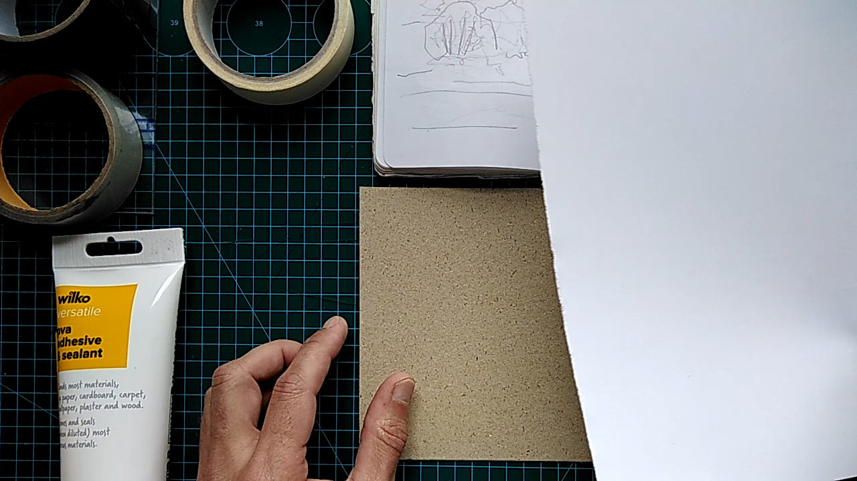
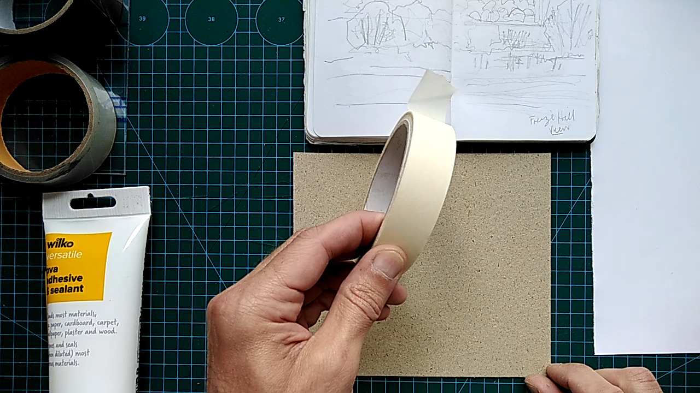
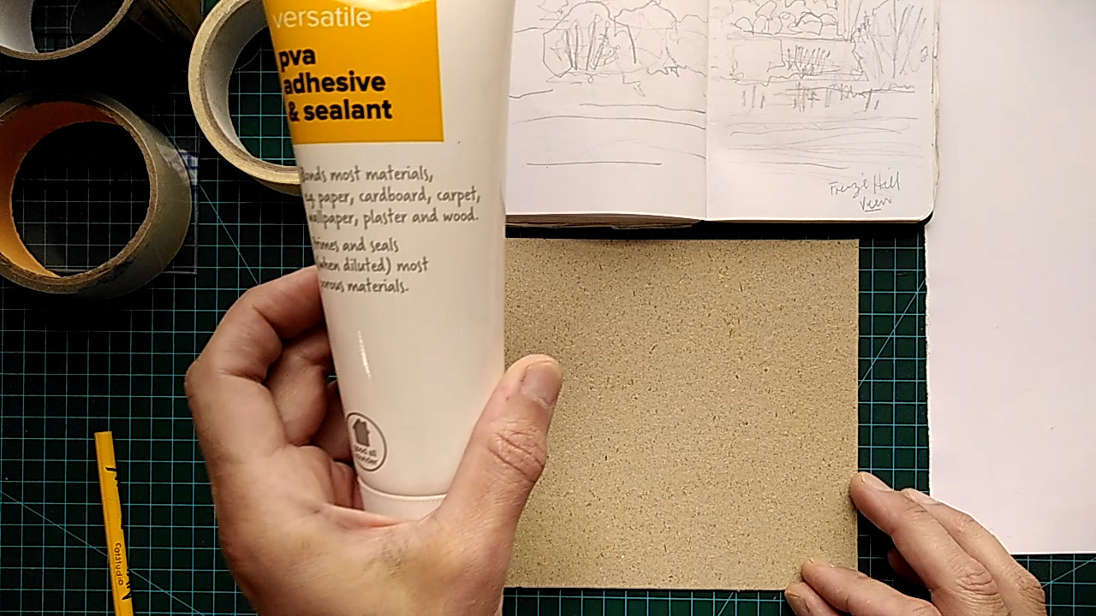

Slide 6
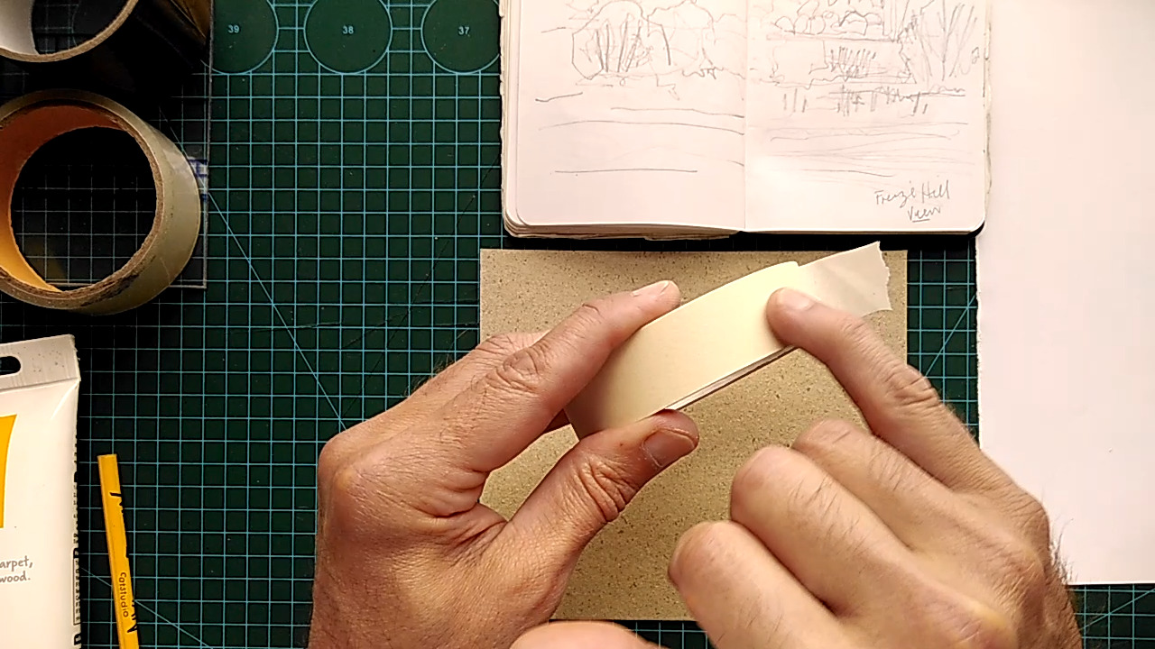
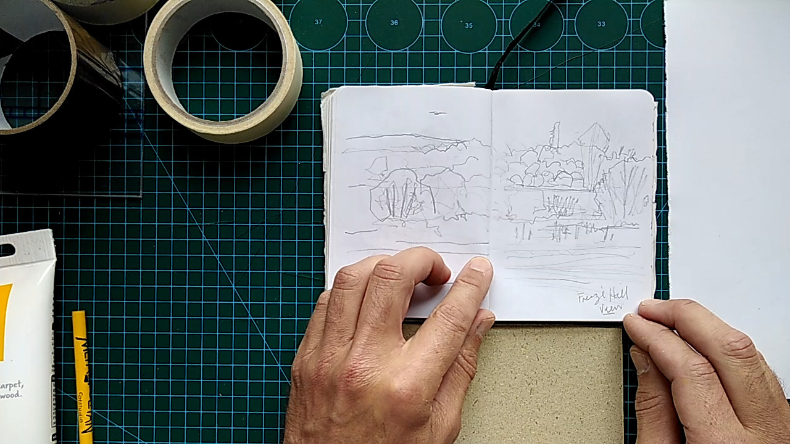
Masking tape has a textured surface that makes interesting marks when printed. sellotape allows you to wipe ink clean from the surface, allowing you to create blank areas of colour.
Sketch of the image you are going to work from to create your collagraph plate.

Slide 7
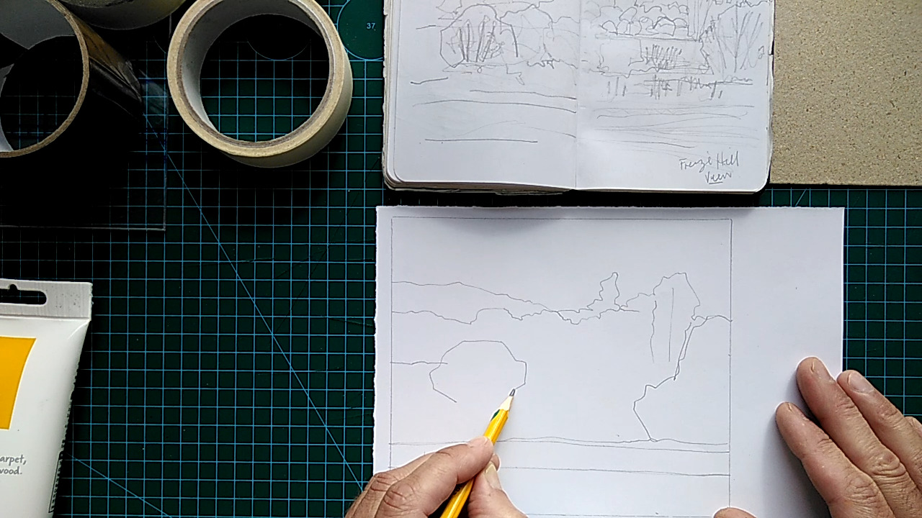
Sketch out the horizon line if you are creating a landscape.
Draw your landscape onto the paper which you will use to rip the shapes from to glue onto your plate.

Slide 8
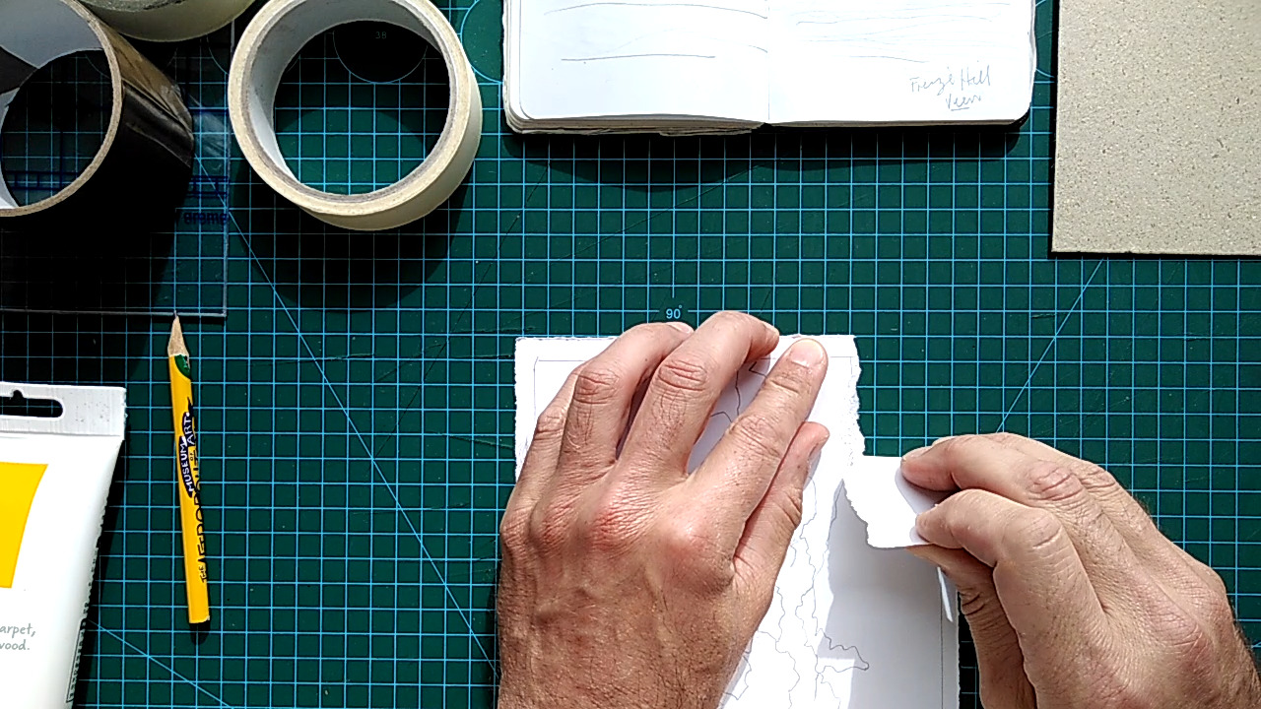
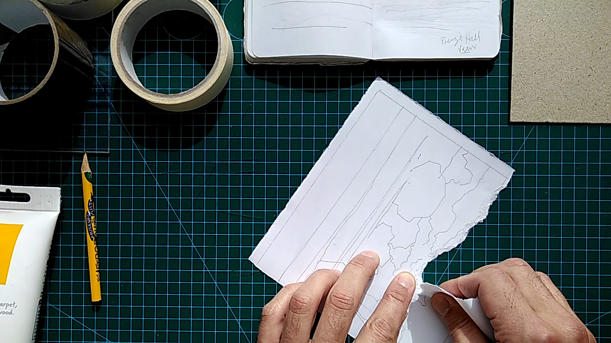
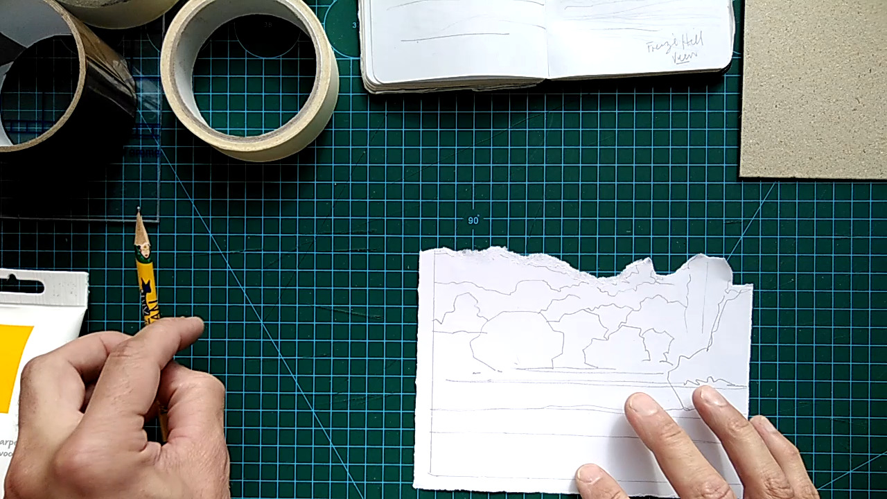
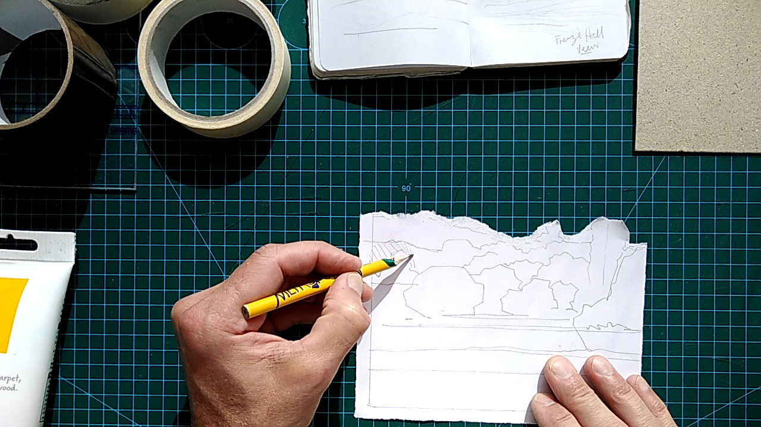
Removing the area of the sky to use elsewhere and shading in areas not required.

Slide 9
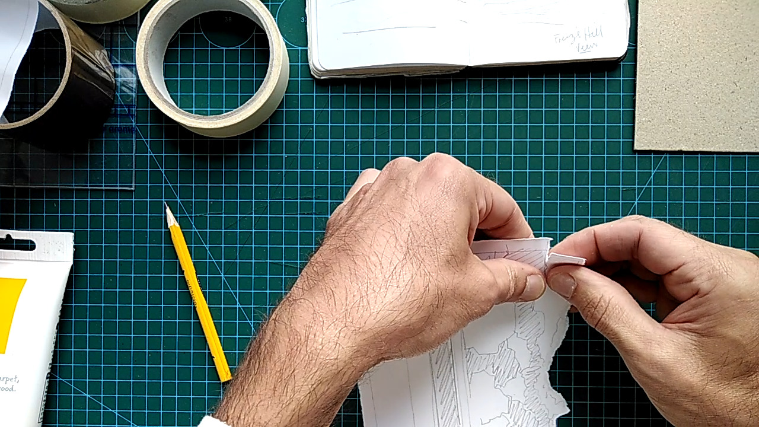
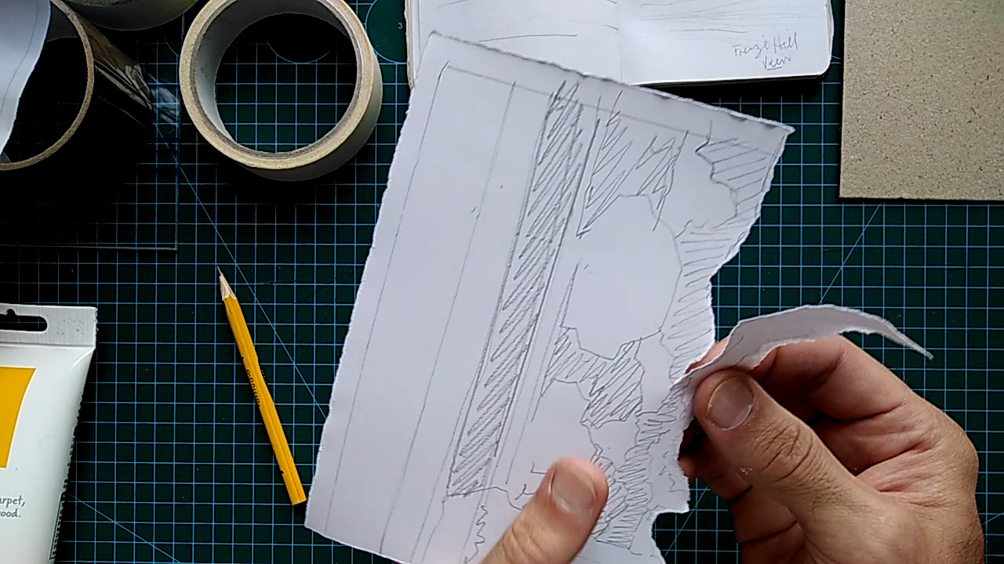
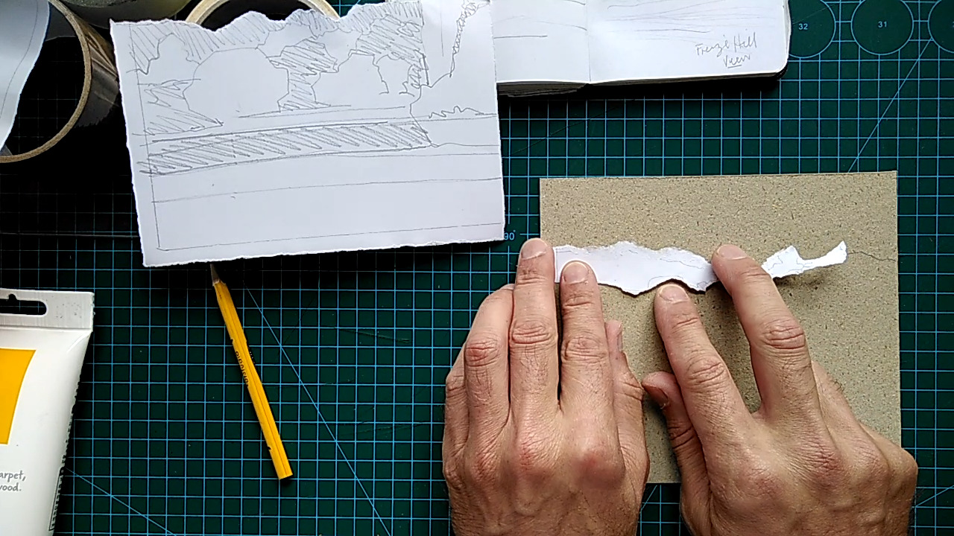
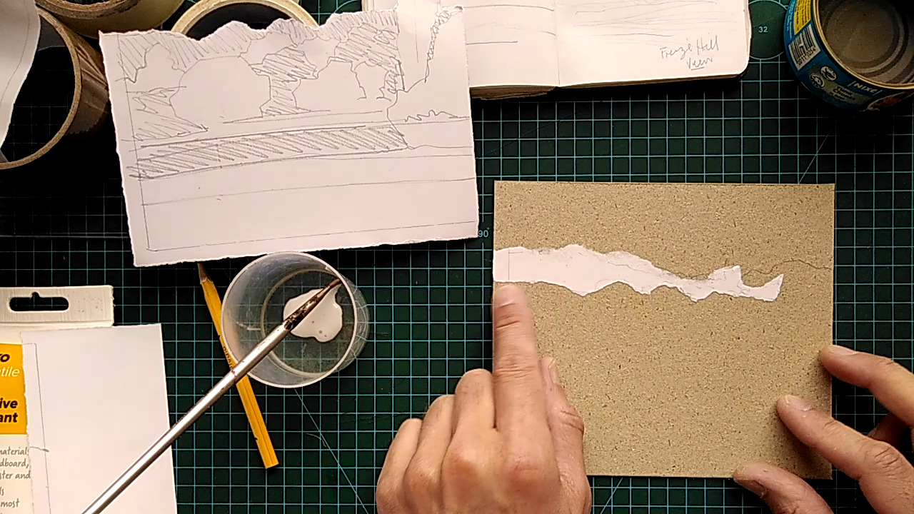
Ripping the paper to separate the non-shaded and shaded areas to glue onto the cardboard plate.

Slide 10
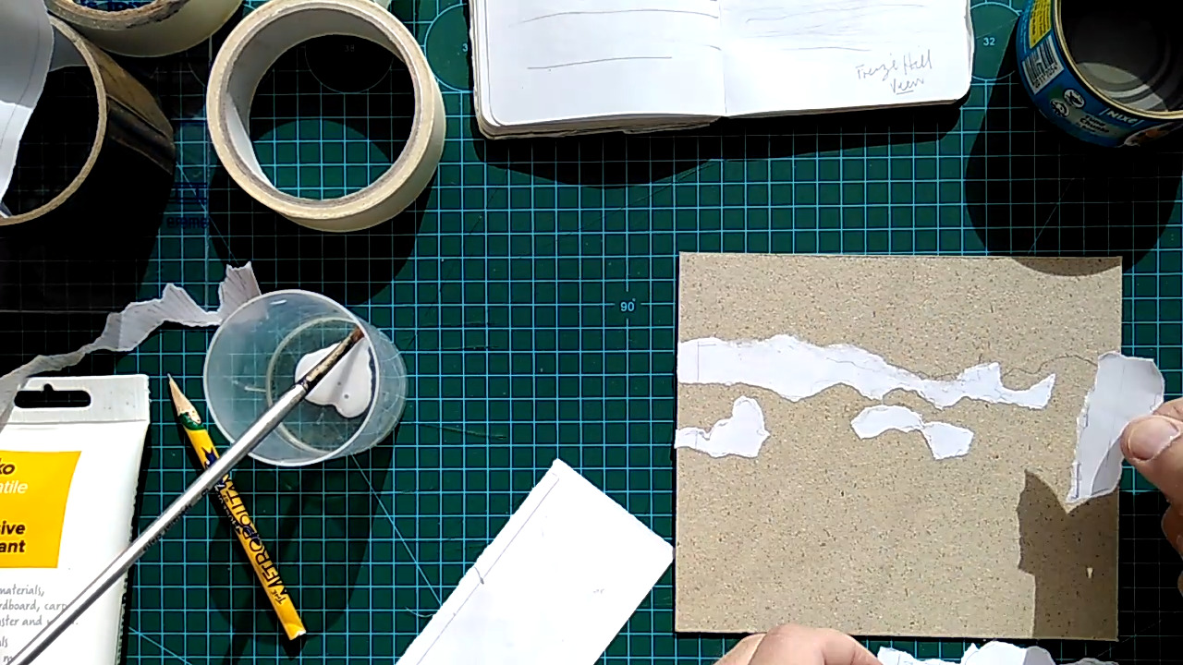
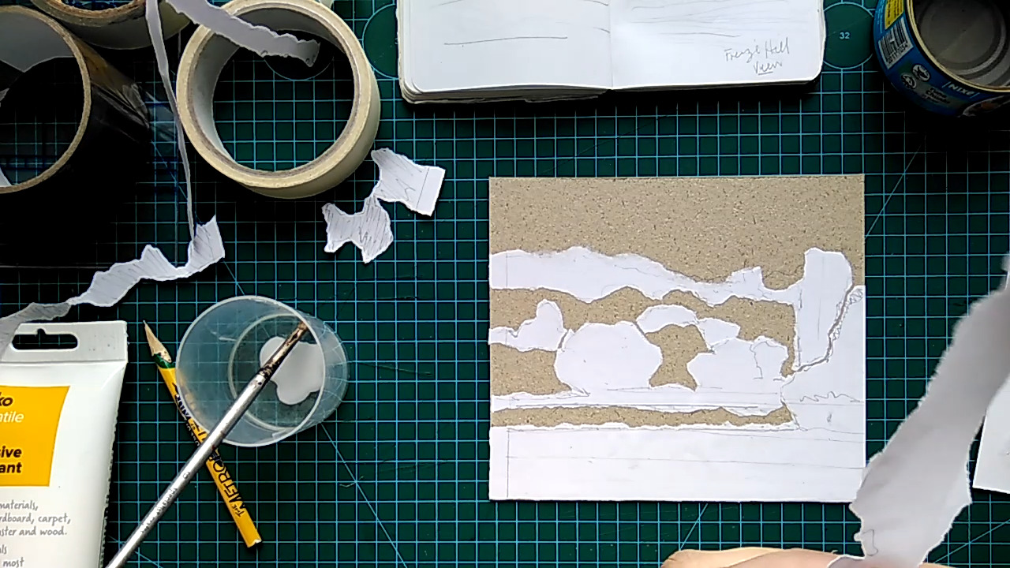
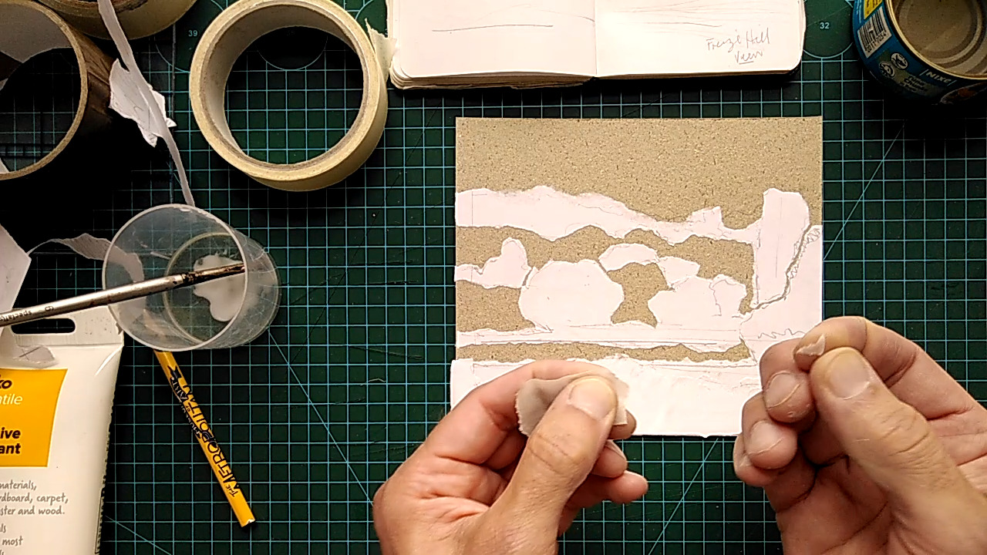
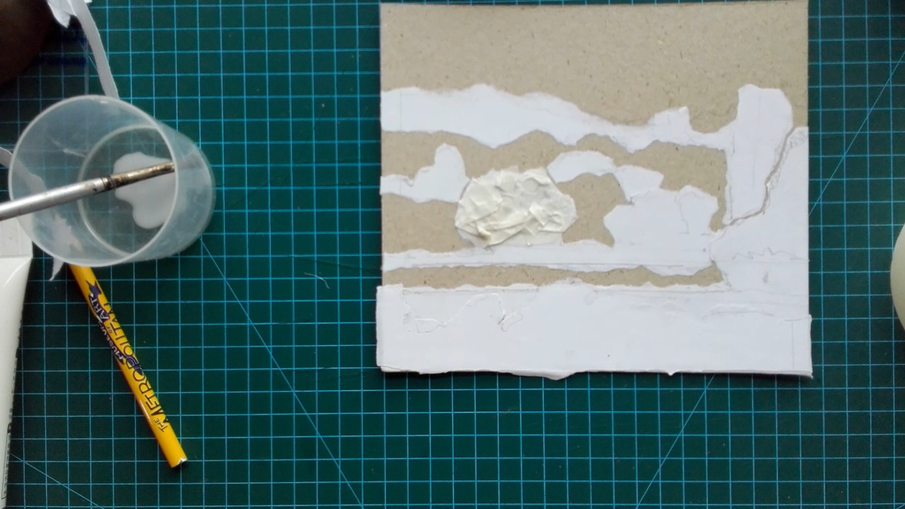
Glue all the non-shaded shapes onto the cardboard to create the raised areas. Add masking tape to create texture.

Slide 11
You can also add other materials like tissue paper and sellotape to create textured surfaces.

Slide 12
Cover the entire surface with a couple layers of PVA glue, allowing each layer to dry before adding the next layer. This will seal the surface ready for the ink.

Slide 13
2. Once the collage is created and the glue is dry:
materials need to be sealed to protect them from the ink. Cover the entire plate with a single coat of PVA and allow to dry.
3. Apply ink to the collage. Work quickly – water-based ink will dry in a short time. Apply ink either by:
Rolling: squeeze a drop of ink out on an inking plate and roll a rubber brayer through it until the roller is covered. Apply to the collage
Daubing: use a sponge or make a hand daubing tool by wrapping a piece of scrap fabric around a ball of more scrap fabric and twisting to form a handle. Dip the dauber in the ink and spread it quickly around the collage. Alternatively you can use a stencil brush to rub the ink onto the surface and use a small piece of cloth to remove the excess ink.

Slide 14
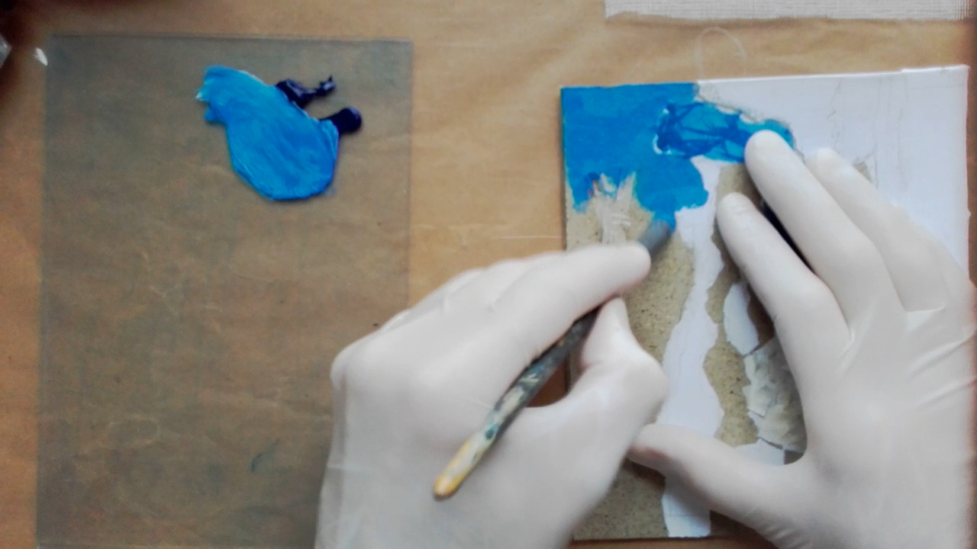
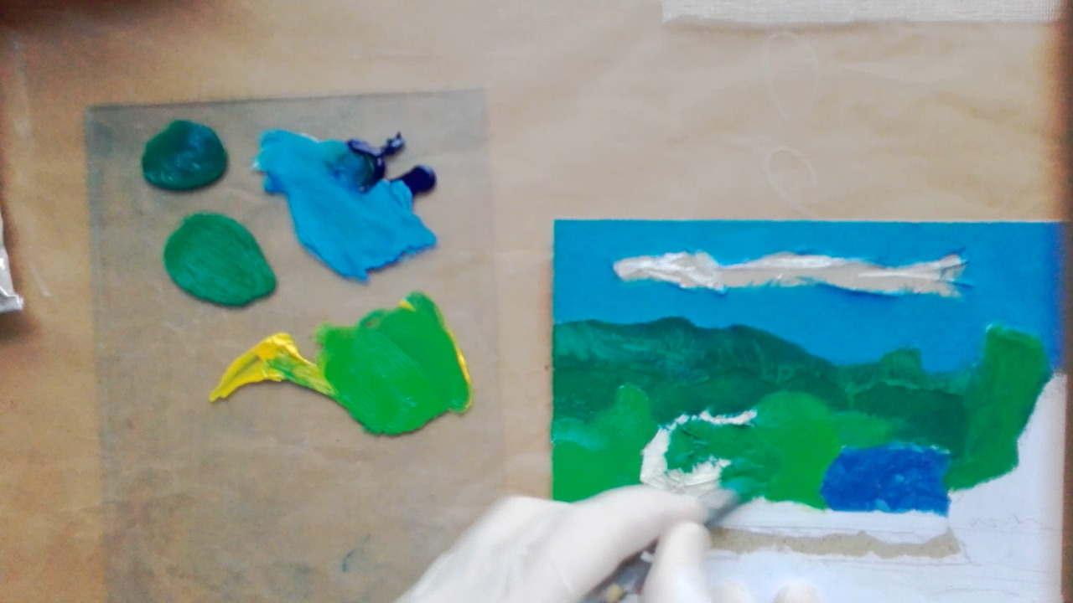
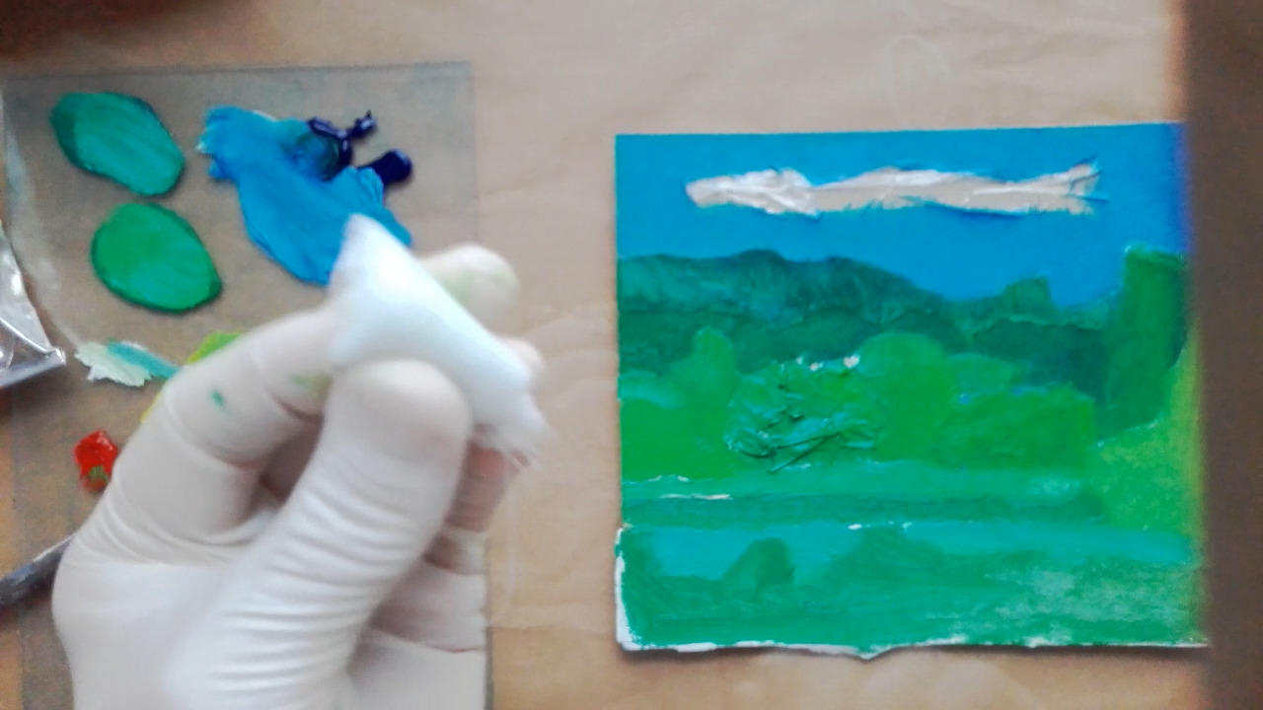
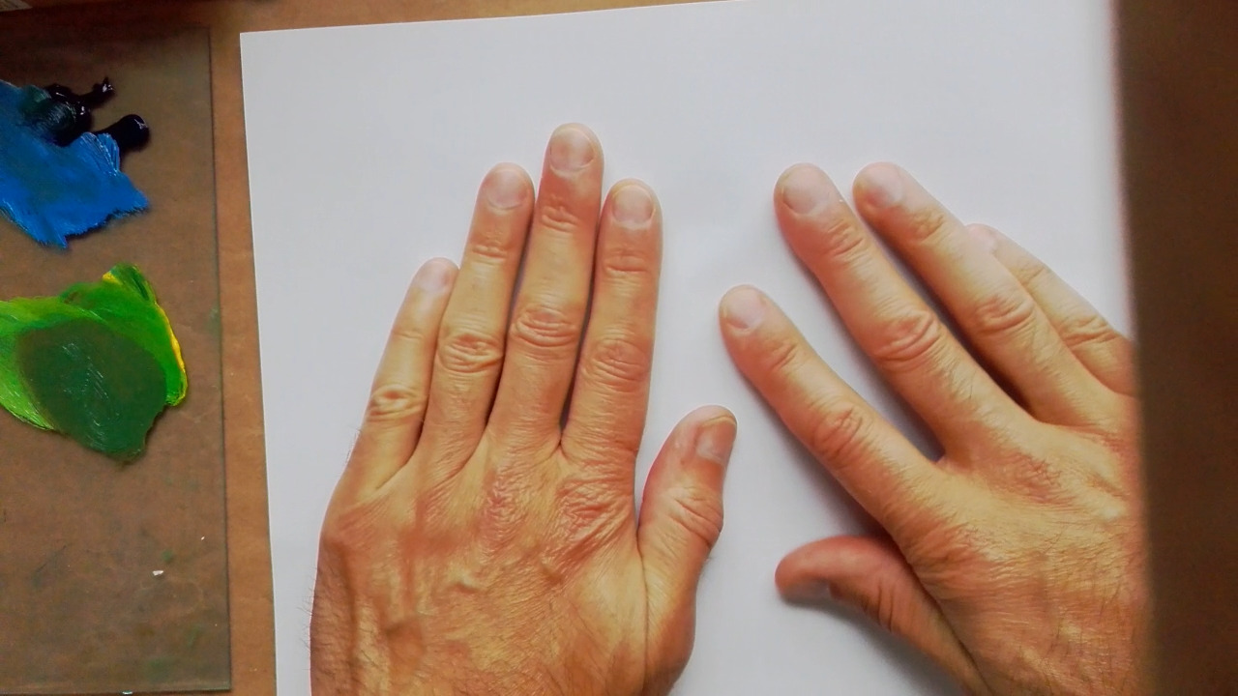
Application of the ink, small cloth to remove the excess and carefully lay paper on top of the printing plate.

Slide 15
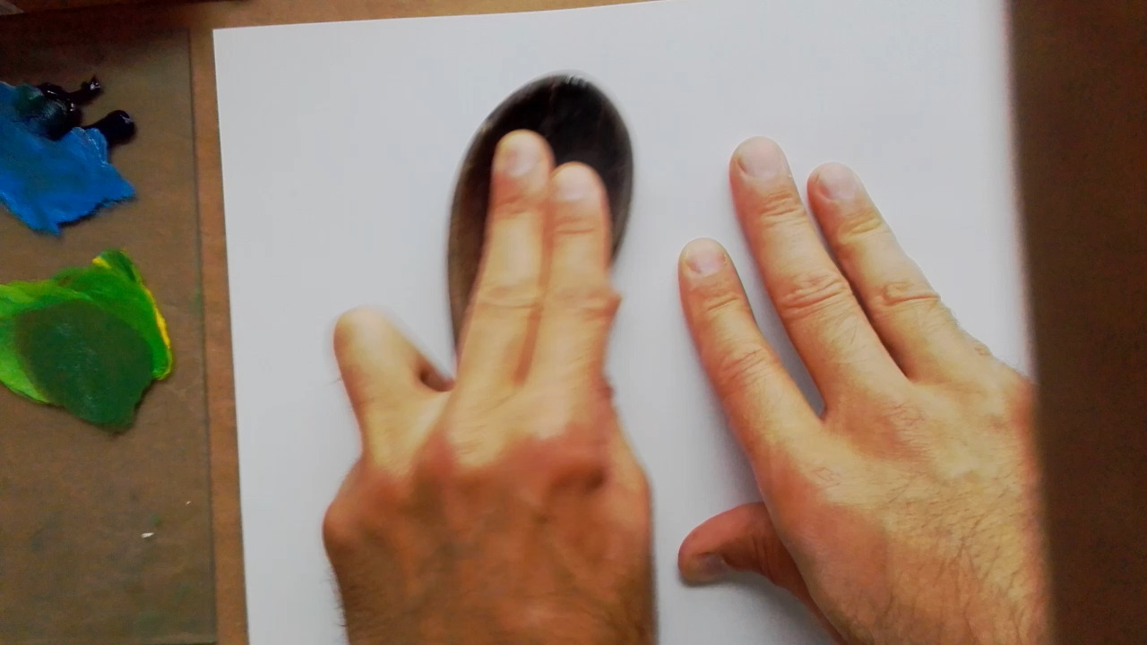
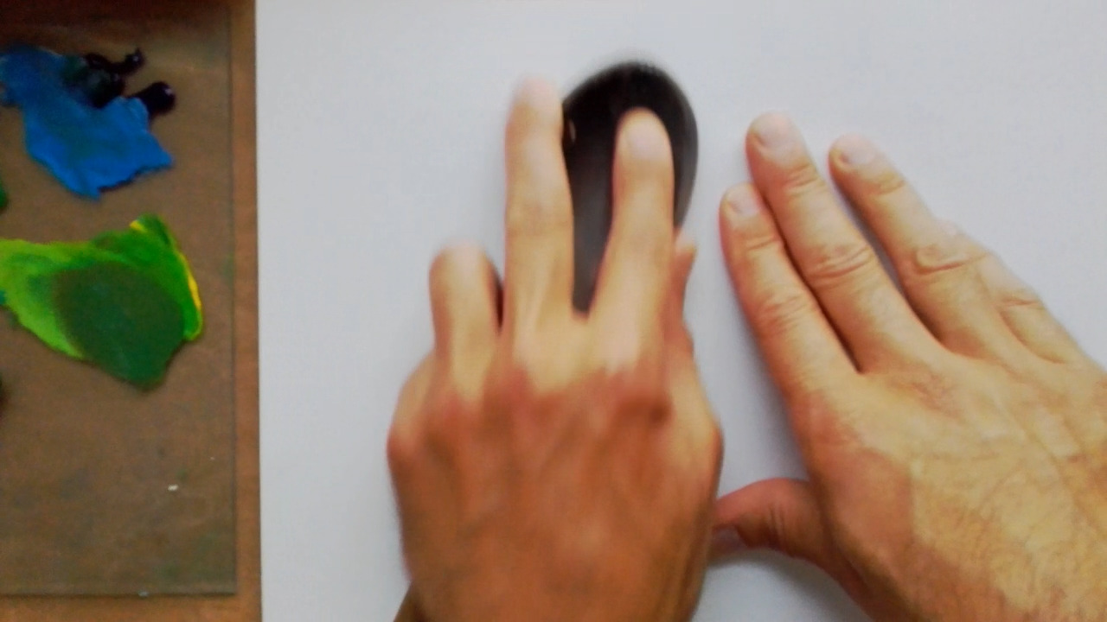
Using one hand to carefully hold the paper so it doesn’t move and use a wooden spoon, table spoon or pressure from your palms (hands) or fingers to press the paper onto the plate, which will pick up the ink.

Slide 16
Revealing the print.

